Slide 1

Realizing the Value of Public Assets
Ensuring a Fair Return to Taxpayers
January 28, 2016

Slide 2








Taxpayers for Common Sense
Nonpartisan budget watchdog that serves
as an independent voice for American taxpayers
Agriculture
Budget & Tax
Earmarks
& Appropriations
Natural Resources
Transportation
& Infrastructure
National Security
Energy
Notes:
What We Want
Government should live within its means.
Federal spending decisions must be transparent and merit-based.
Federal programs and agencies must be subject to effective oversight, regular evaluation, and independent financial audits.
Effective transparency means information is easily accessible, timely, and usable by the general public.
Government spending should give the taxpayers the best possible return on their investment.
How to Cut Waste
If it doesn't work, don't fund it; if we don’t need it, don’t buy it.
Cut unnecessary subsidies and corporate welfare.
Avoid unnecessary long-term liability for the taxpayer.
Expose and stop corruption.
Don’t just give away government assets.
Our Issues
Agriculture
Budget & Tax
Earmarks & Appropriations
Energy
National Security
Natural Resources
Transportation & Infrastructure

Slide 3
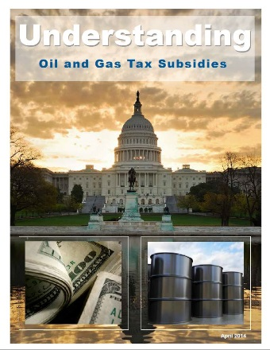
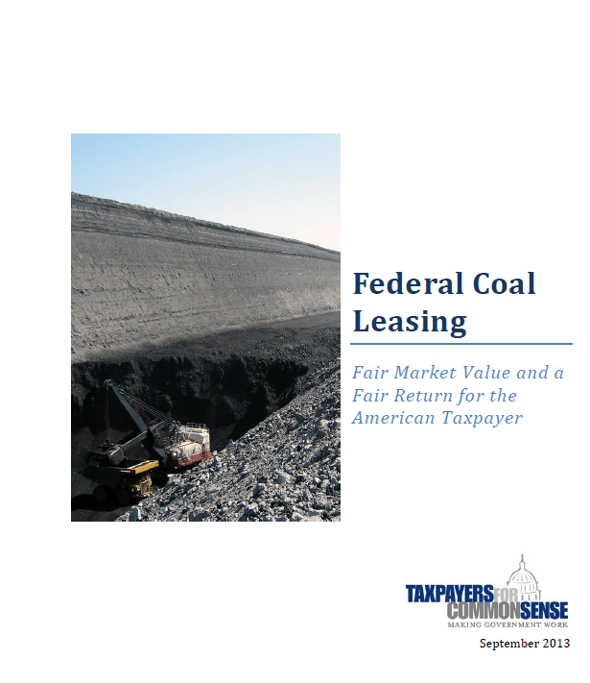

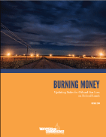
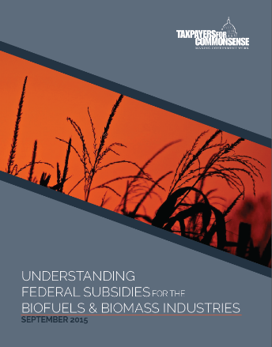
Energy and Natural Resources
Federal Coal Leasing:
Fair Market Value and a Fair Return for the American Taxpayer
Fair Market Value for Wind and Solar Development on Public Lands
Understanding
Oil and Gas Tax Subsidies
Burning Money:
Updating Rules
for Oil and Gas Loss on Public Lands
Understanding Federal Subsidies for the Biofuels & Biomass Industries

Slide 4
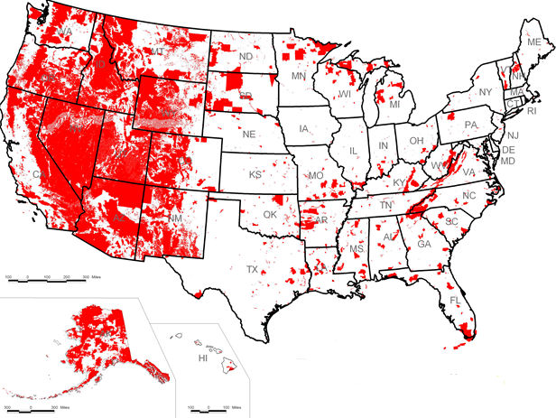
What Are Our Taxpayer Assets?
Federal Mineral Rights
U.S. federal lands and waters contain a vast array of minerals and potential energy sources that are an enormous public asset.
The leasing policies transferring rights to these resources should recover full value for the taxpayer.
Notes:
United States federal lands and waters contain a vast array of minerals and potential energy sources that must be acknowledged as an enormous public asset.
The leasing policies transferring rights to these resources should recover full value for the taxpayer.
Oil
Natural gas
Coal
Hardrock minerals (gold, silver, and copper)
Timber
Renewable resources
Wind
Solar
Geothermal

Slide 5
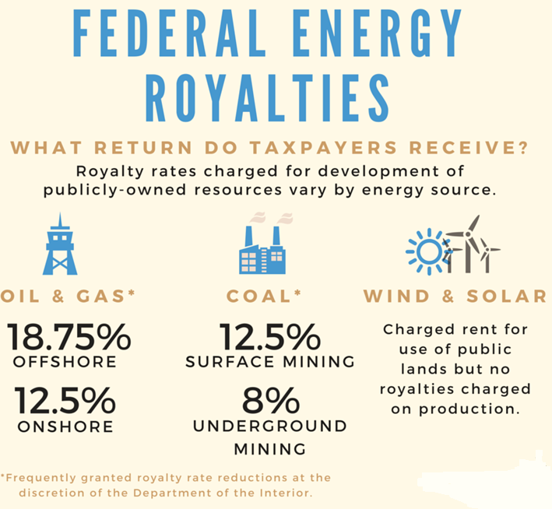
Notes:
No Two Development Programs the Same
The laws and policies governing the leasing of energy resources vary tremendously.
Adopted at many different times without any effort to create a consistent federal energy program.
The leasing systems currently in use for offshore and onshore energy development on federal lands present a dizzying array of financial terms.
No two systems have more than a term or two in common, and none provides a full assurance of fair return to the taxpayer.

Slide 6

How Do We Get Revenue?
Mineral Leasing Rights
Terms of Lease
Bonus Bid
Rent
Royalties
Notes:
How we currently get revenues as owners
Private operators bid for leases for the rights to remove minerals from federal lands and waters
Operators who win rights to lease pay a bonus bid, rent, royalties,
Bonus Bid
These bids allocate leases to the entity willing to pay the most for the resources, and help ensure recovery of fair market value for federally owned resources.
Rent
Royalty
Royalties are charges for oil and gas leasing based on the value of the mineral produced

Slide 7
Oil and Gas – Current Policies
 | Term of Lease | Royalty | Rental | Bonus Bids
Offshore | 5-10 years, varying by water depth and diligence in exploration if production begins during lease term, extended through life of production | 18.75% of market value allowances deducted for transportation and processing costs | $7.00 - $11.00/acre annually for first 5 years, depending on water depth $14.00 - $44.00/acre annually in subsequent years, depending on water depth and year of lease | $25.00 - $100.00/acre minimum bid, depending on water depth bid reviewed to ensure adequacy before lease issued – if value is insufficient, lease is rejected
Onshore | 10 years if production begins during lease term, extended through life of production | 12.5% of market value allowances deducted for transportation and processing costs | $1.50/acre annually for first five years $2.00/acre annually in subsequent years | $2.00/acre minimum bid no review of bid adequacy
Notes:
Offshore
The Bureau of Offshore Energy Management (BOEM) leases these lands for oil and gas development under the terms of the Outer Continental Shelf Lands Act (OCSLA)
Royalties are charges for oil and gas leasing based on the value of the oil and gas produced. In 2008, the Department of the Interior increased the offshore oil and gas royalty rate to 18.75% of market value.
Onshore
The Bureau of Land Management (BLM) leases onshore oil and gas resources on lands owned by BLM and the U.S. Forest Service as well as other federal lands under the terms of the Mineral Leasing Act of 1920 as amended.
As with offshore oil and gas, lessees are charged rental fees during the period that they hold the right to drill on federal lands, whether or not oil and gas is actually produced. The current rental rate is $1.50 per acre per year for the first 5 years, and $2 per acre thereafter (as with the royalty rate, the rental rate is the minimum allowed under the law)
Under the Mineral Leasing Act, oil and gas lease sales are held quarterly by each BLM state office, or more often some states with high demand. Lease sales are held in public meetings, with oral bidding for bonus bids.

Slide 8

Oil and Gas – Proposed Rulemakings
Venting and Flaring of Natural Gas
Requires use of equipment and processes to limit amount of flared gas
Establishes leak detection and repair program
Limits monthly amount of gas flared
Prohibits venting of gas except in emergency
Onshore Oil and Gas Royalty Rates, etc.
Considering changes to the royalty rates, rental payments, minimum bonus bids and bonding requirements for oil and gas leases on federal lands
Onshore Oil and Gas Operations
Universal adoption of approved Facility Measurement Points
Notes:
Rulemaking on Venting and Flaring
In 2014, there were more than 23,000 producing oil and gas leases on federal lands, accounting for 3.5 trillion cubic feet of natural gas sales – roughly 14 percent of total U.S. production..
Under the existing rules, oil and gas companies may release unlimited amounts of natural gas from federal leases through venting or flaring, most of it royalty free. The total amount of royalty-free lost gas has almost tripled in recent years, from 22.7 billion cubic feet in 2006 to 66.8 billion cubic feet in 2014.
Last Friday, BLM released a proposed rule that would address the problem of lost gas. The proposed rule would:
Require the use equipment and processes to limit amount of flared gas
Establish leak detection and repair program
Limit monthly amount of gas that can be flared
Prohibit venting of gas, except in cases of emergency
Rulemaking on Royalties for Onshore Oil and Gas
BLM is also considering changes to the royalty rates, rental payments, minimum bonus bids and bonding requirements for oil and gas leases on federal lands.
None of these financial requirements has been revised in decades, and numerous GAO reports have raised concerns about whether federal oil and gas development collects a fair return for taxpayers.
Rulemaking on Onshore Oil and Gas Operations
BLM faces an enormous challenge in ensuring accurate measurement of production at more than one hundred thousand oil and gas wells: inspectors traveling many miles to witness the calibration of meters that later, sometimes years later, turn out not to be the ones used to measure production
We believe the universal adoption of approved Facility Measurement Points, or FMPs, for onshore federal oil and gas wells must be implemented immediately.

Slide 9
Coal – Current Policies
Term of Lease | Royalty | Rental | Bonus Bids
20 years, but may be extended if necessary to complete production from the property if no commercial production after 10 years, lease terminated | 8% for underground mines 12.5% for surface mines rate may be reduced as low as 2% upon request of lessee to ensure full production allowances deducted for transportation and processing costs production | $3.00/acre annually | $100.00/acre minimum bid must be “fair market value” – bids rejected if they don’t meet value assessed by BLM in advance
Notes:
General
Like onshore oil and gas, leasing for coal development on all federal lands is conducted by the BLM in accordance with the Mineral Leasing Act.
major provisions affecting modern coal leasing were adopted in the Federal Coal Leasing Amendments Act of 1976.
Although the basic structure of the law and regulations requires that coal leasing be conducted under land use plans specifically prepared for coal production, BLM has not used this process for many years
Now leases are issued under a “lease by application” process, which I will discuss more
Royalty
BLM currently sets the royalty rate for surface mining at 12.5% and underground mining at 8%.
BLM can reduce the royalty rate to as low as 2% in order to ensure that recoverable coal will not be bypassed during mining

Slide 10
Coal – Programmatic Review
Programmatic Environmental Impact Statement (PEIS) will review:
Leasing mechanisms to determine how, when, and where to lease
If policies ensure a fair return to taxpayers, including current royalty rates
BLM will institute a “pause” on issuing new coal leases while the review is underway.
BLM will also issue guidance “in the near term” that will:
Require State and field offices to post online notice of requests to lease coal or to reduce royalties
Clarify the process for royalty rate reductions
Authorize the capture and sale of waste mine methane
Notes:
On January 16, the Interior Department announced it will prepare a Programmatic Environmental Impact Statement (PEIS) that will identify and evaluate potential reforms to the federal coal program, the first time in more than 30 years.
Interior will look at:
appropriate leasing mechanisms for coal
environmental and public health impacts of the coal program
royalty rates
whether U.S. coal exports should factor into leasing

Slide 11
Interior Should Look Closely At…
Lack of Competition
The predominant coal leasing process – Lease by Application – effectively lets coal companies draw the tracts they want to lease, resulting in few competitive bids and below-market returns for taxpayers.
Weak Valuation Procedures
The disparity between the price of coal at the mine mouth where royalties are calculated and the price at market suggests a market failure, and taxpayers are the ones getting shorted.
Outdated Royalty Rates and Excessive Reductions
Current coal royalty rates established 40 years ago. Offshore oil and gas have higher rate, and BLM considering increased rates for onshore oil and gas.
Nearly half of all coal leases between 1990-2013 received a royalty rate reduction.
Notes:
BLM has

Slide 12

Money-Losing Timber Sales
National Forest System
Consists of 193 million acres of public forests and grasslands managed by the U.S. Forest Service.
The Tongass National Forest is the largest national forest in the United States at 16.9 million acres, roughly the size of West Virginia, and is located in southeastern Alaska.
Money-Losing Timber Sales
USFS spends more taxpayer money preparing and administering timber sales than it receives for the timber.
From 2008 through 2013, the USFS spent $139.1 million on timber sales in the Tongass and received $8.6 million in proceeds, a net loss of $130.5 million.

Slide 13
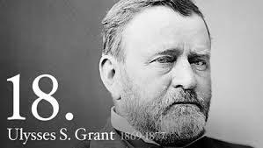
Hardrock Mining
General Mining Law of 1872
Mining companies pay no royalties to the federal government for hardrock minerals extracted from taxpayer-owned lands.
The estimated value of hardrock minerals extracted from federal lands $1 billion annually.
Omission of these minerals from federal royalty collection is projected to have cost taxpayers $100 million.
Notes:
Hardrock development includes minerals such as gold, silver, copper and gravel.
Rules for hardrock mining set when Ulysses S Grant was president
the lack of federal royalties charged on hardrock minerals shows economic favoritism towards the hardrock mining industry.
Adoption of a federal royalty on hardrock minerals would not notably alter mineral exploration on federal lands

Slide 14
Renewables
 | Term of Lease | Royalty | Rental | Bonus Bids
Offshore | 5-year development lease 25-year production operating lease if project development is successful | Formula based on total energy generated, electricity rates charged by lessee – approx. 2% of gross operating income | $3.00/acre annually until commercial operations begin | Multi-factor competitive bidding, including both fiscal factors and credits for other operating features
Onshore | 3-year project development right-of-way 30-year project operating right-of-way | No royalty | $15.70 – 313.88/acre annually for solar projects, depending on county where project located $4,155/megawatt of installed capacity annually, reduced to 25% of that total in the first year and 50% in the second year | No competitive bidding Processing fee based on hours of staff time to process right-of-way application
Notes:
Offshore
The Energy Policy Act of 2005 extended BOEM’s offshore leasing authority to include offshore leasing for renewable energy development
Lease Terms
The lease terms for renewable energy leases provide for a development period (5 years) followed an operating period (25 years)
Royalty
The law requires that BOEM recover “fair return” for renewable energy leases.
While fees paid for renewable energy leases that produce electricity are not the same as royalties, the operating fees they pay are approximately equivalent to royalties.
BOEM has set a formula for these operating fees of approximately 2% of the gross operating income of the project.
Onshore
Solar and wind energy projects proposed for onshore public lands are authorized by permits for rights-of-way under BLM’s Federal Land Policy and Management Act (FLPMA) permitting process
Right-of-way permits do not require any competitive leasing or bidding process.
In September 2014, BLM proposed new regulations for competitive leasing for solar and wind energy on BLM lands, including provisions that would establish preferred leasing areas for solar and wind projects and govern rights-of-way, rentals, and bonding. Final rules have not yet been issued.
In our comments on this rulemaking, TCS supported the proposed creation of a megawatt capacity fee based on:
size of the approved project,
potential electric generation,
average wholesale prices of electricity,
and a Federal rate of return based on a 20-year Treasury bond.

Slide 15
Long-term Liabilities - Bonding
Coal
“Self-bonding” allows operators to avoid posting collateral for reclamation bonds. Bankruptcies in coal industry have demonstrated weakness of self-bonding and left taxpayers with reclamation costs.
Oil & Gas
Bond amounts are not based on the full reclamation costs for each site, but are instead based on regulatory minimums intended to ensure that the operator complies with all the terms of the lease.
Wind and Solar
GAO found bonding policies for wind and solar projects to be inconsistent, unreliable, and inadequate.
Notes:
Coal
Alpha Natural Resources Inc filed for bankruptcy in August 2015, leaving taxpayers to cover more than $670 million in self-bonded liabilities.
Arch Coal, which has $459 million in self-bonds, filed for bankruptcy on January 11.
Peabody Coal, which lost more than $300 million in the third quarter of 2015, is currently under investigation for using its subsidiaries to qualify for self-bonding.
Oil & Gas
BLM’s bond amounts are not based on the full reclamation costs for each site that would be incurred by the government if an operator were to fail to complete the required reclamation. Instead, BLM’s onshore oil and gas bonds are based on regulatory minimums intended to ensure that the operator complies with all the terms of the lease.
In recent comments to BLM, TCS has said: “The BLM oil and gas bonding policy should be changed to cover all potential reclamation costs, and ensure that lessees meet their duty to protect taxpayers from financial risk.”
Renewables
GAO found that: BLM has limited assurance that bonds for wind and solar rights-of-way will cover reclamation costs, leaving the federal government potentially at financial risk if developers do not complete reclamation.
GAO found about one-third of the wind and solar rights-of-way were under-bonded by as much as $15 million in total.

Slide 16
Fair Return to Taxpayers
Revenues from the collection of royalties represent one of the largest non-tax income sources for the federal government.
Fair and accurate collection is necessary to ensure taxpayers are receiving what they are owed.
Many of the rules governing different aspects of federal energy programs are decades old and have not kept pace with changes in energy markets and technology.
In general, federal energy development systems should be aligned to conform to a consistent set of standards that will ensure adequate recovery for federal resources.

